Slide 1
Parallax-tolerant Image Stitching
Bhavya Kalra(2018701005)
Shrutimoy Das(2018701011)

Slide 2
Introduction
Image stitching or photo stitching is the process of combining multiple photographic images with overlapping fields of view to produce a segmented panorama or high-resolution image.
Parallax handling is a challenging task for image stitching.
We present a local stitching method to handle parallax based on the observation that input images do not need to be perfectly aligned over the whole overlapping region for stitching. .
We then develop an efficient randomized algorithm to search for a homography, which, allows for optimal stitching.

Slide 3

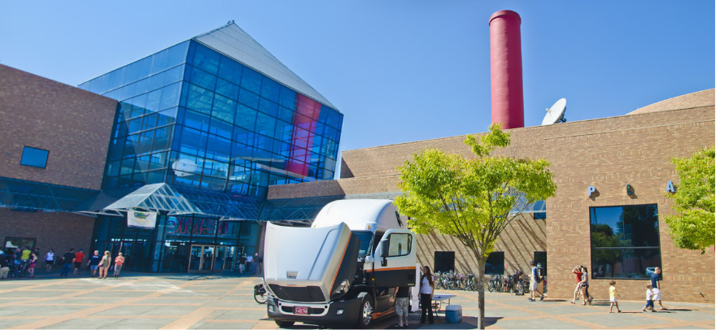
Objective of the Project
Input Images :
Expected Output:

Slide 4
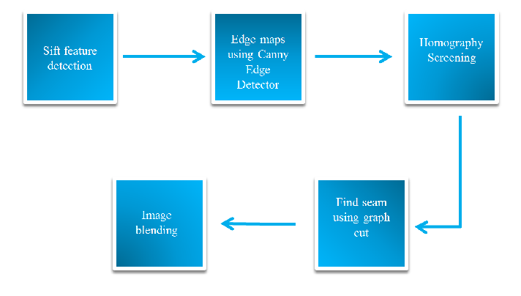
Project Pipeline

Slide 5
Algorithm
Detect Sift features for input images and edge maps of those images.
Randomly select a seed feature point and group its spatially nearest neighbors one by one until the selected feature set cannot be fitted by a homography with a pre-defined threshold.
Evaluate the alignment quality of the best-fitting homography from Step 2. If the homography meets the pre-defined quality threshold, go to Step 4. Otherwise, if the average penalty value is low, go to Step 2; otherwise select the best homography estimated during the iteration process and go to Step 4.
Employ the optimal homography to pre-align images and use moving DLT followed by simple linear blending.

Slide 6
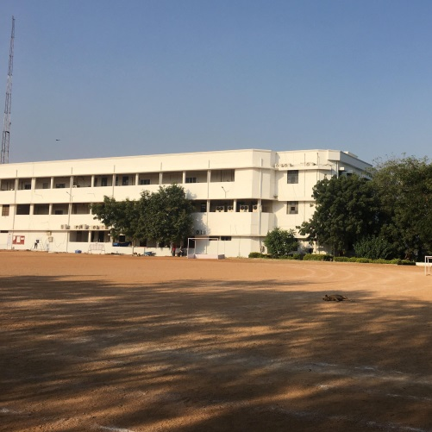
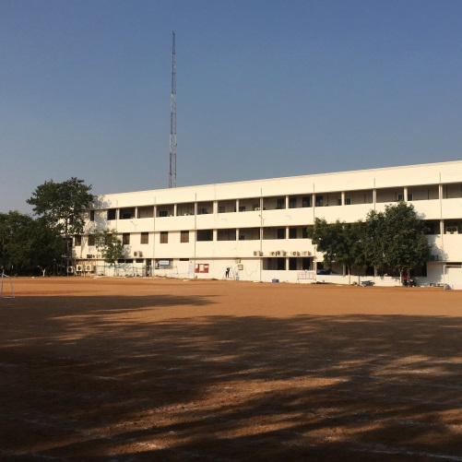
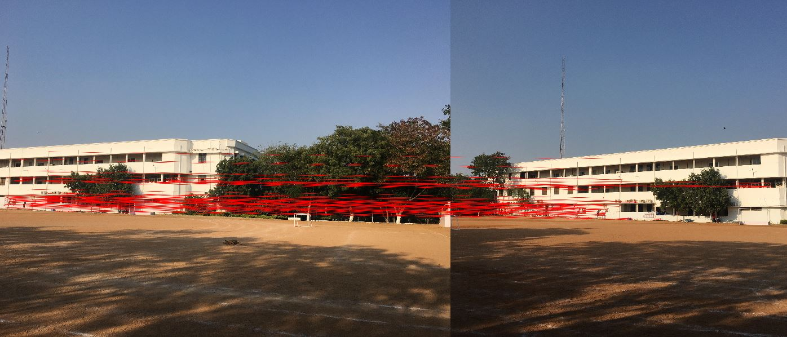
Sift on input images

Slide 7
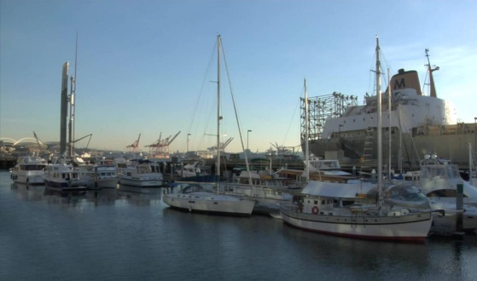
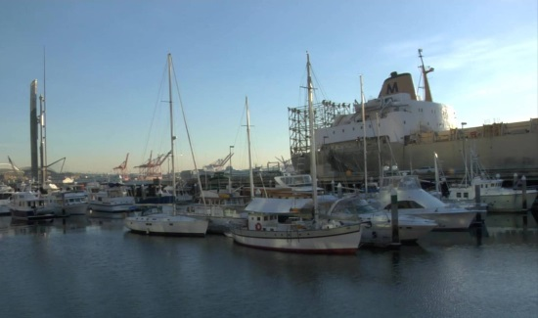
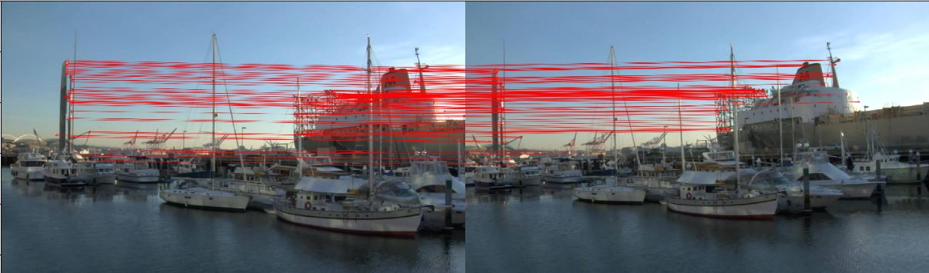
Sift on input images

Slide 8
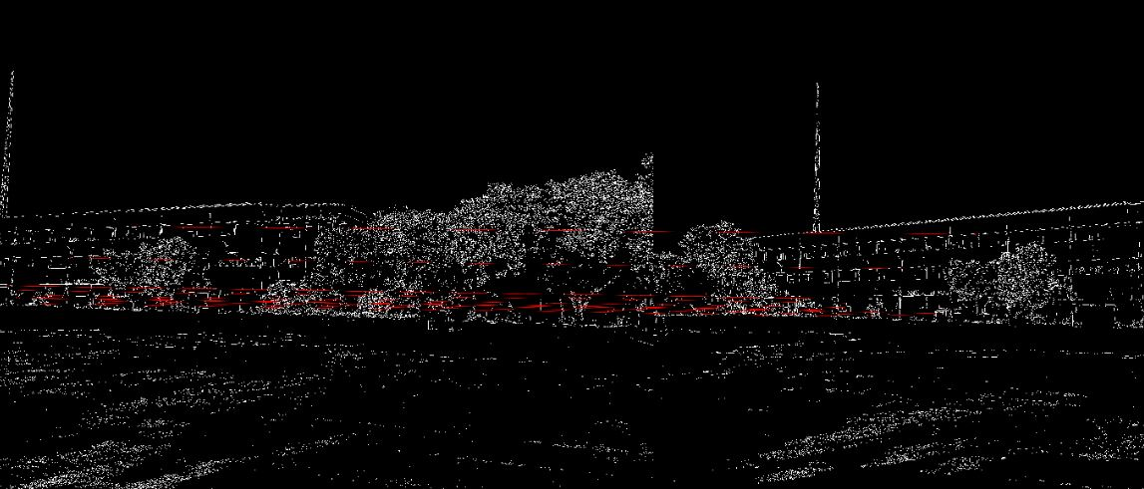
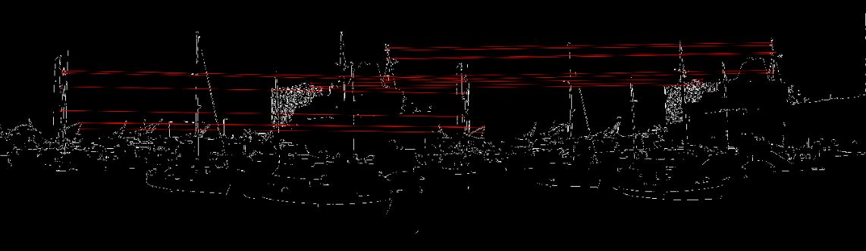
Sift on Edge Maps

Slide 9
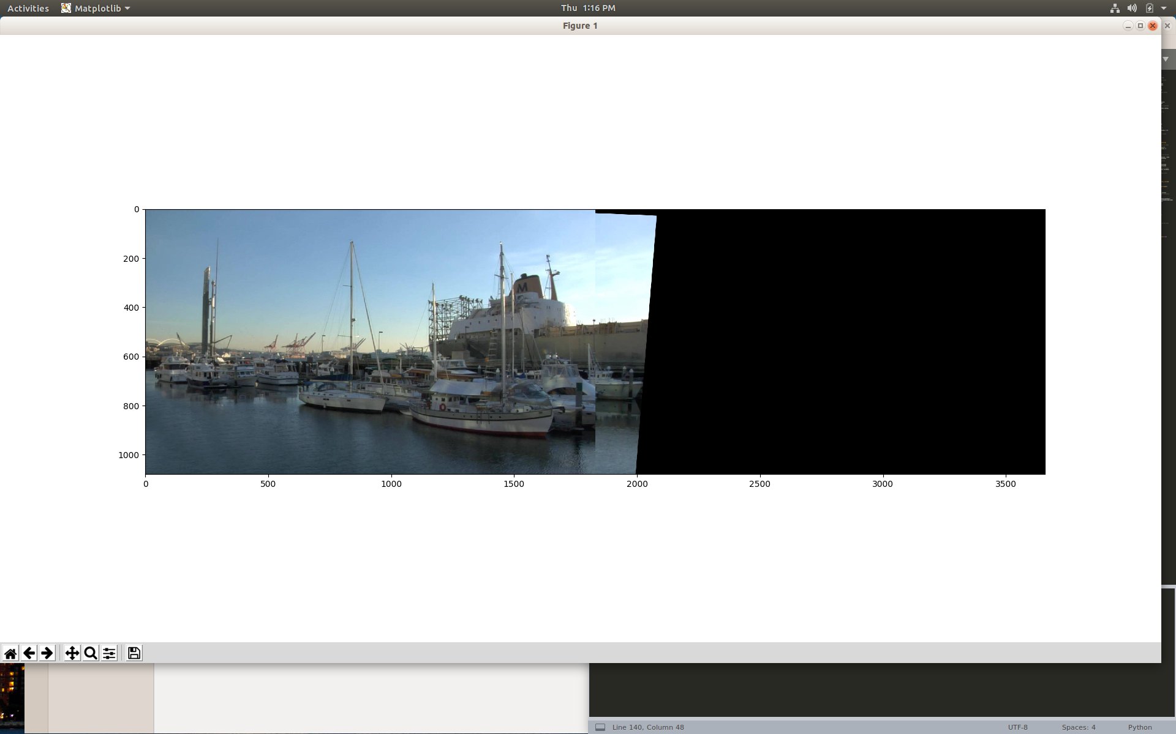
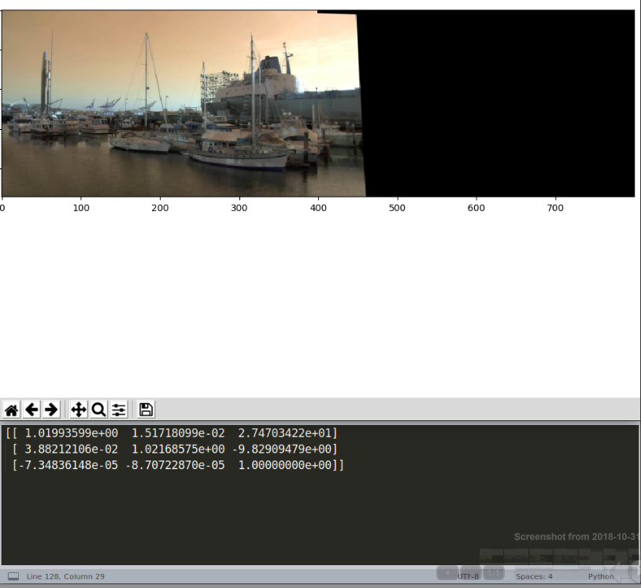
Results from using RANSAC for homography screening

Slide 10
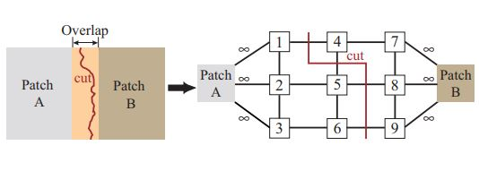
Seam Finding using Graph-Cut Method
Design the seam finding problem as a graph-cut(maxflow) problem
Find the cut that minimizes the cost of the edges
(Image Courtesy : https://www.cc.gatech.edu/~turk/my_papers/graph_cuts.pdf)

Slide 11
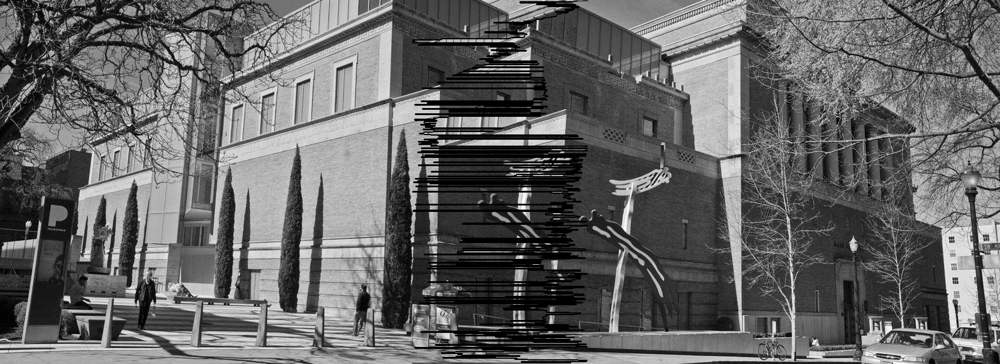
Results using simple cost function
Cost = difference in intensities of neighbouring pixels

Slide 12
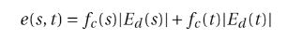
Seam finding using inclusive cost function
Avoid seam through pixels having large values in the edge difference map for seamless stitching.
Use the information of interest points and alignment to define the cost function.

Slide 13
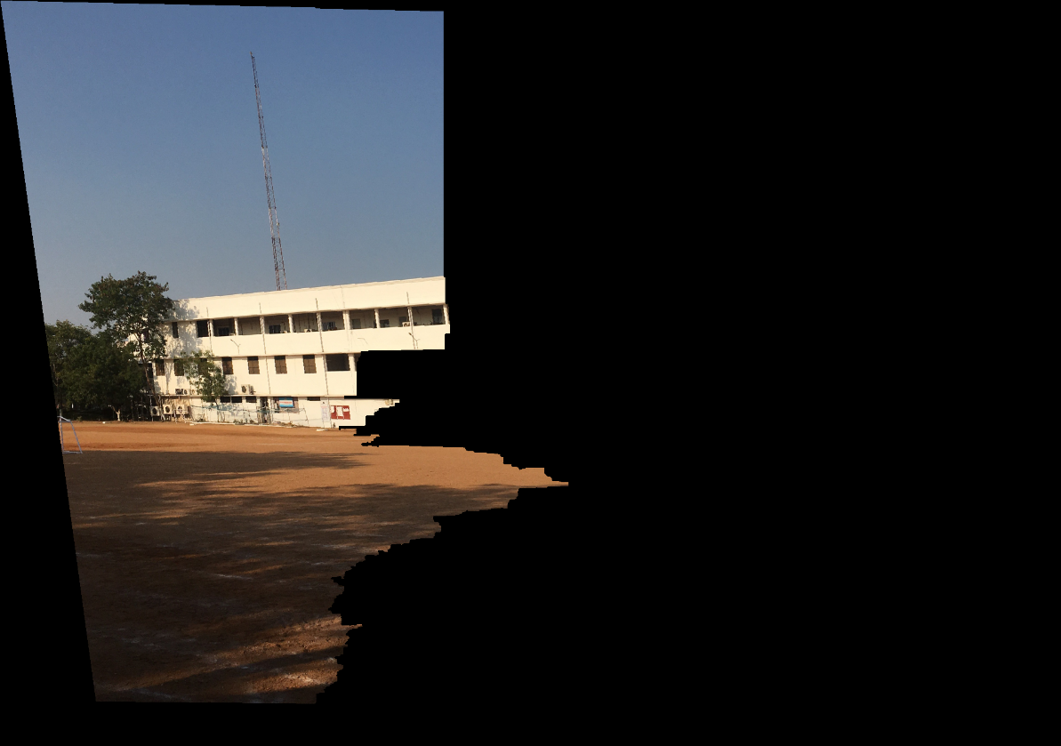
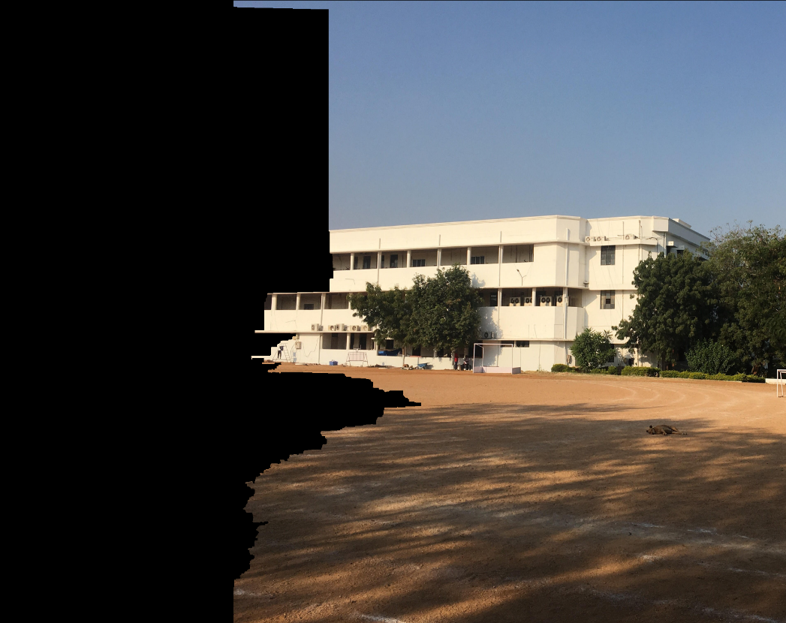
Result of seam finding

Slide 14
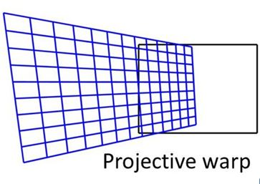
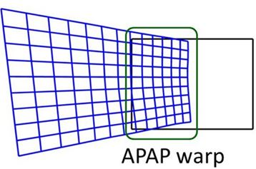
Local Alignment
While the projective warping is global homography, the moving DLT(direct linear transformation) technique works at local alignment on the basis of a grid/mesh.
Images taken from https://slideplayer.com/slide/5285969/

Slide 15
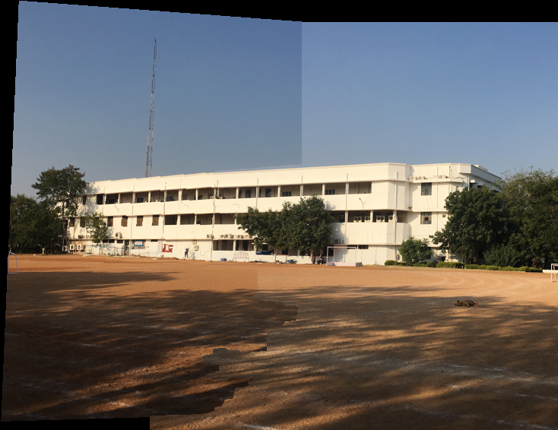
Blended Image

Slide 16
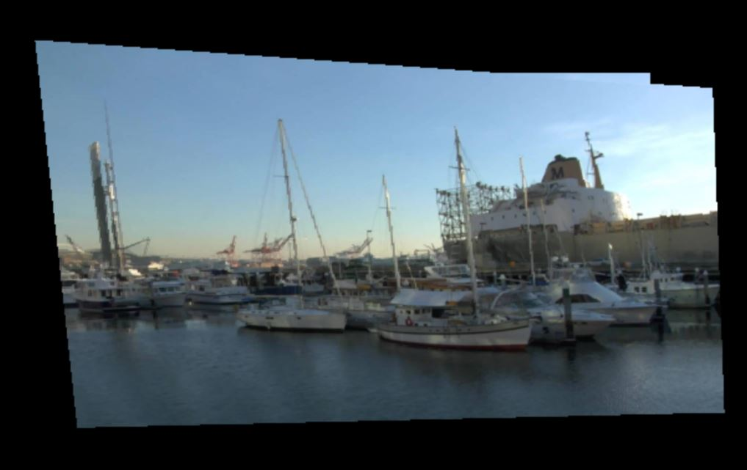
Blended Image

Slide 17
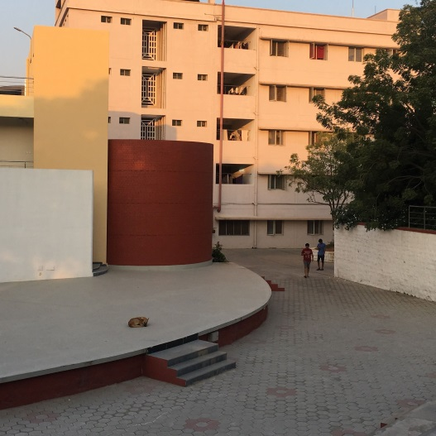
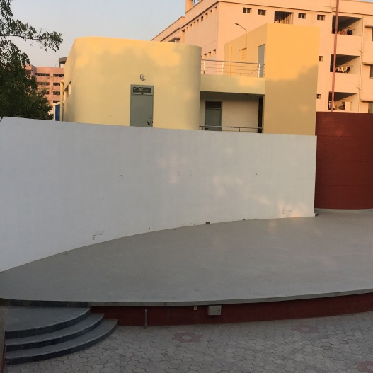
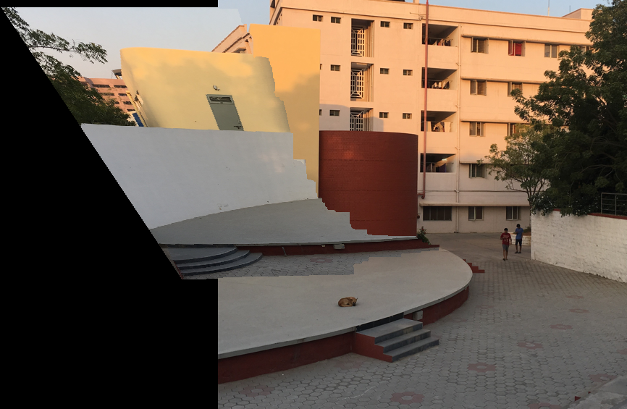
Unsuccessful examples

Slide 18
THANK YOU!

